Slide 1
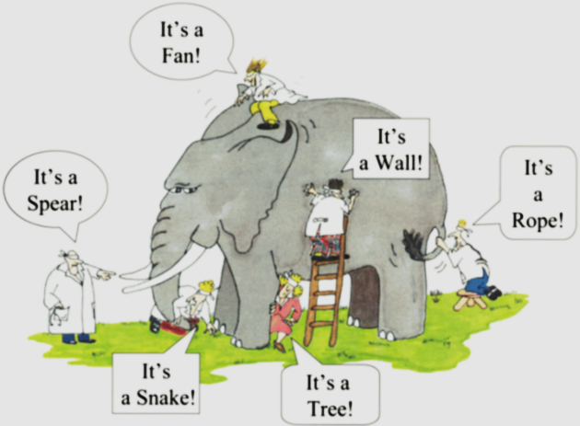
Sampling Methods
Zulkarnain Lubis

Slide 2

Sampling Methods
  The Need to Sample
  Sampling, Statistical terms and tests
  Identify Sampling design
  The size of the sample
  The sampling methods
    probability sampling (Simple random, Systematic, Stratified random, Cluster, Multi-stage
    non probability sampling (Accidental Sampling. Purposive Sampling, Expert Sampling, Quota sampling, Self-selection Sampling)

Slide 3

RESEARCH PROCESS
Identify and Define Research Problem
Theory / Practice
Hypotheses / Conceptualization
Research Design
Data collection
Data Analysis
Findings

Slide 4
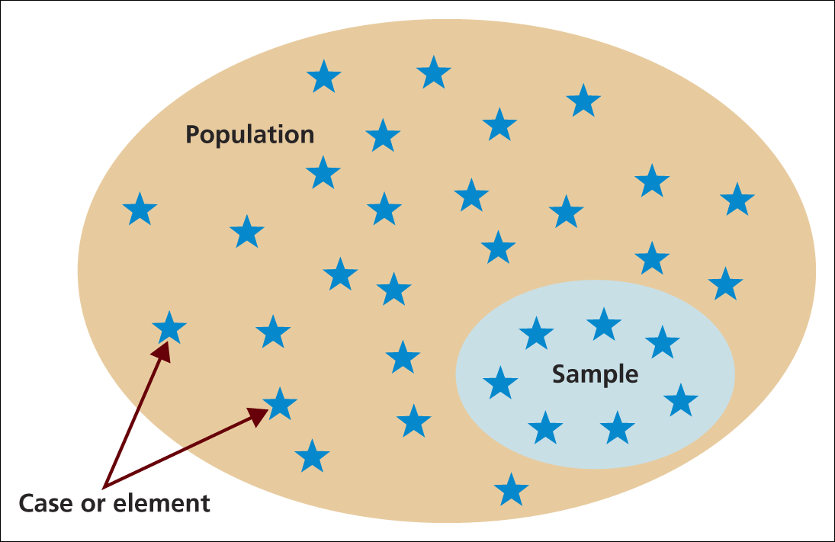
Selecting Samples
Population, sample and individual cases

Slide 5

The Need to Sample
Sampling- a valid alternative to a census when
A survey of the entire population is impracticable
Budget constraints restrict data collection
Time constraints restrict data collection
Results from data collection are needed quickly

Slide 6
Practical Sampling Concepts
Defining the Target Population
  What is the relevant population?
  Whom do we want to talk to?
    Population is operationally defined by specific and explicit tangible characteristics.
The Sampling Frame
  A list of elements from which a sample may be drawn; also called working population.
  Sampling Frame Error
    Occurs when certain sample elements are not listed or are not accurately represented in a sampling frame.

Slide 7
Practical Sampling Concepts (cont’d)
Sampling services (list brokers)
  Provide lists or databases of the names, addresses, phone numbers, and e-mail addresses of specific populations.
  Reverse directory
    A directory similar to a telephone directory except that listings are by city and street address or by phone number rather than alphabetical by last name.
International Research
  Availability of sampling frames varies dramatically around the world.

Slide 8

Sampling Units
Sampling Unit
  A single element or group of elements subject to selection in the sample.
  Primary Sampling Unit (PSU)
    A unit selected in the first stage of sampling.
  Secondary Sampling Unit
    A unit selected in the second stage of sampling.
  Tertiary Sampling Unit
    A unit selected in the third stage of sampling.

Slide 9
Random Sampling and Non sampling Errors
Random Sampling Error
  The difference between the sample result and the result of a census conducted using identical procedures.
  A statistical fluctuation that occurs because of chance variations in the elements selected for a sample.
Systematic Sampling Error
  Systematic (nonsampling) error results from nonsampling factors, primarily the nature of a study’s design and the correctness of execution.
    It is not due to chance fluctuation.

Slide 10

Random Sampling and Nonsampling Errors (cont’d)
Less than Perfectly Representative Samples
  Random sampling errors and systematic errors associated with the sampling process may combine to yield a sample that is less than perfectly representative of the population.

Slide 11
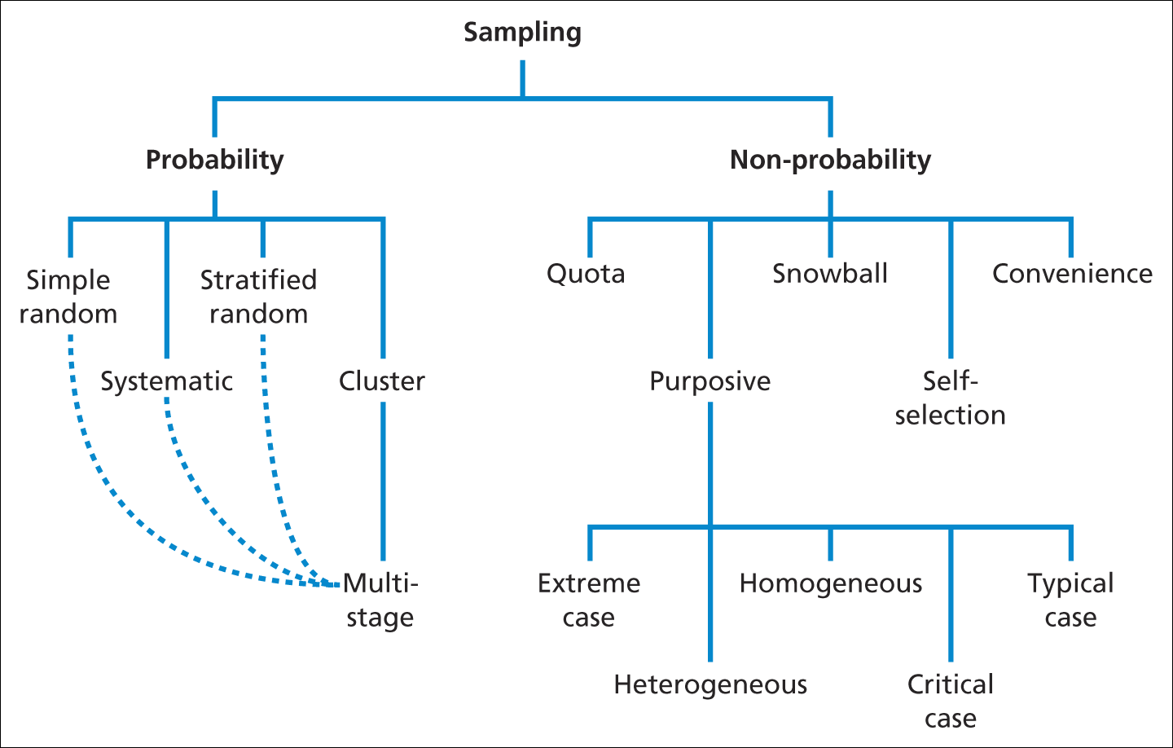
Overview of Sampling Techniques
Sampling techniques
Figure 7.2 Sampling techniques

Slide 12
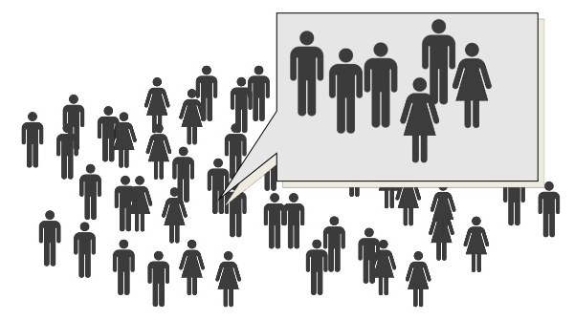
When the sample is representative ?
The size of the sample
The sampling methods

Slide 13

Sample Size
Random Error and Sample Size
  Random sampling error varies with samples of different sizes.
  Increases in sample size reduce sampling error at a decreasing rate.
    Diminishing returns - random sampling error is inversely proportional to the square root of n.

Slide 14
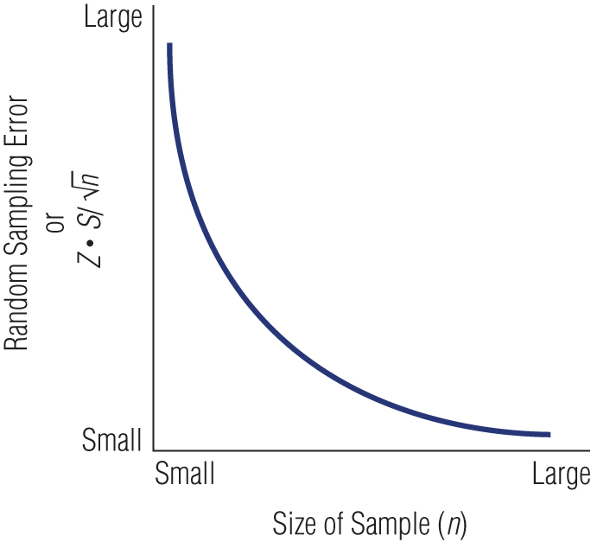
Relationship between Sample Size and Error
mistake

Slide 15
The Sample Size
the sample size is determined based on
  the comparison of sample size to the population size
  the level of homogeneity or uniformity of the population
  the sampling method used
  the level of precision desired
  the purpose of the research
  the availability of budget and time

Slide 16
Factors of Concern in Choosing Sample Size
Variance (or Heterogeneity)
  A heterogeneous population has more variance (a larger standard deviation) which will require a larger sample.
  A homogeneous population has less variance (a smaller standard deviation) which permits a smaller sample.
Magnitude of Error (Confidence Interval)
  How precise must the estimate be?
Confidence Level
  How much error will be tolerated?

Slide 17
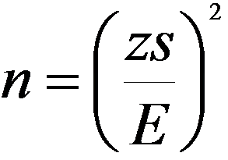
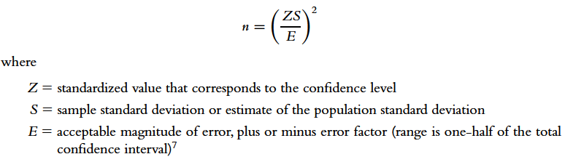
Estimating Sample Size for Questions
Involving Means
Sequential Sampling
  Conducting a pilot study to estimate the population parameters so that another, larger sample of the appropriate sample size may be drawn.
Estimating sample size:

Slide 18
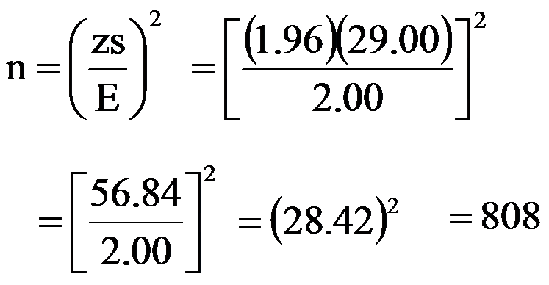
Sample Size Example
Suppose a survey researcher, studying expenditures on lipstick, wishes to have a 95 percent confident level (Z) and a range of error (E) of less than $2.00. The estimate of the standard deviation is $29.00. What is the calculated sample size?

Slide 19

Sample Size Example
Suppose, in the same example as the one before, the range of error (E) is acceptable at $4.00. Sample size is reduced.

Slide 20
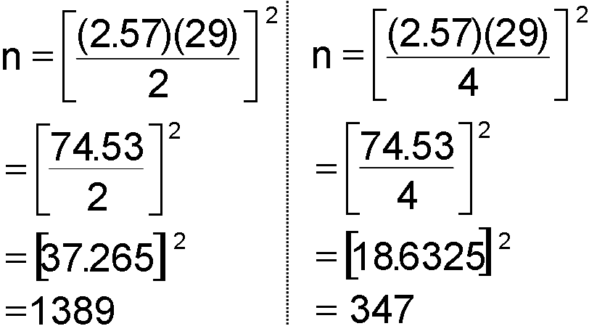
Calculating Sample Size at the 99 Percent Confidence Level

Slide 21


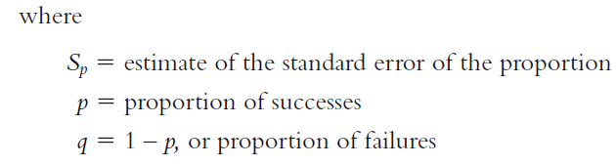
Determining Sample Size for Proportions

Slide 22
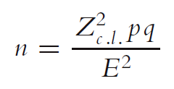
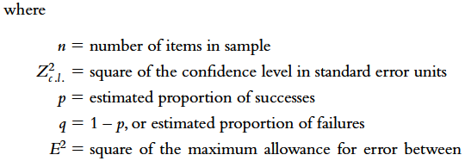
Determining Sample Size for Proportions (cont’d)

Slide 23

Calculating Example Sample Size at the 95 Percent Confidence Level
p
=
.
6
(
96
2
)(.
1.
)
(.
6
4
)
n
=
q
=
.
4
( .
035
)
2
(
3
.
8416
)(.
24
)
=
001225
.
922
=
.
001225
=
753

Slide 24
Sampling Methods
probability sampling: Selecting sample is based on the consideration of the probability theory
non probability sampling: The sample is selected based on certain considerations, does not use the probability theory approach, and without random
Probability sampling is better to use in selecting sample, but in reality it is often not possible. If so, then non probability sampling can be used as an alternative

Slide 25
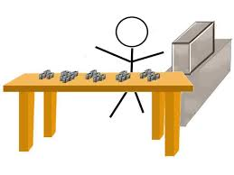
Probability Sampling
Simple random
Systematic
Stratified random
Cluster
Multi-stage

Slide 26
Simple Random Sampling
  Assures each element in the population of an equal chance of being included in the sample.
Systematic Sampling
  A starting point is selected by a random process and then every nth number on the list is selected.
Stratified Sampling
  Simple random subsamples that are more or less equal on some characteristic are drawn from within each stratum of the population.

Slide 27
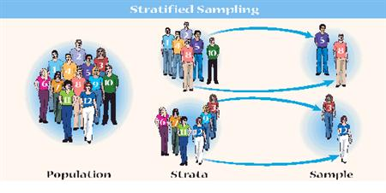
Proportional Stratified Sample
  The number of sampling units drawn from each stratum is in proportion to the population size of that stratum.
Disproportional Stratified Sample
  The sample size for each stratum is allocated according to analytical considerations.

Slide 28
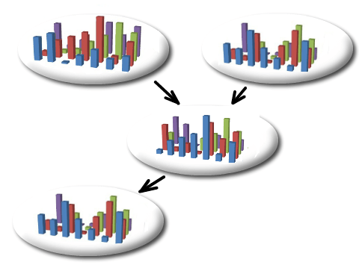
Cluster Sampling
  An economically efficient sampling technique in which the primary sampling unit is not the individual element in the population but a large cluster of elements.
  Clusters are selected randomly.

Slide 29
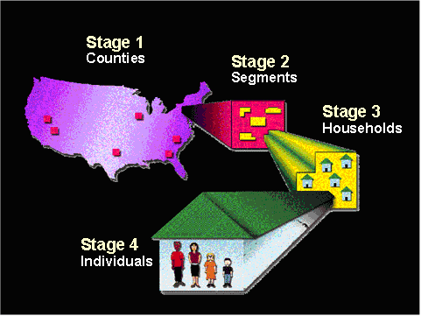
Multistage Area Sampling
  Involves using a combination of two or more probability sampling techniques.
    Typically, geographic areas are randomly selected in progressively smaller (lower-population) units.
    Researchers may take as many steps as necessary to achieve a representative sample.
    Progressively smaller geographic areas are chosen until a single housing unit is selected for interviewing.

Slide 30

Non- Probability Sampling
Accidental Sampling. It is also called as Convenience Sampling Opportunity Sampling, or Haphazard Sampling
Purposive Sampling
Expert Sampling
Quota sampling: Proportionate Quota Sampling, Non-proportionate Quota Sampling, and Snowball Sampling
Self-selection Sampling

Slide 31
Convenience Sampling
  Obtaining those people or units that are most conveniently available.
Judgment (Purposive) Sampling
  An experienced individual selects the sample based on personal judgment about some appropriate characteristic of the sample member.
Quota Sampling
  Ensures that various subgroups of a population will be represented on pertinent characteristics to the exact extent that the investigator desires.

Slide 32

Snowball Sampling
  A sampling procedure in which initial respondents are selected by probability methods and additional respondents are obtained from information provided by the initial respondents.

Slide 33

Summary
Choice of sampling techniques depends upon the research question(s) and their objectives
Factors affecting sample size include:
- confidence needed in the findings
- accuracy required
- likely categories for analysis

Slide 34

Summary
Probability sampling requires a sampling frame and can be more time consuming
When a sampling frame is not possible, non- probability sampling is used
Many research projects use a combination of sampling techniques

